Slide 1
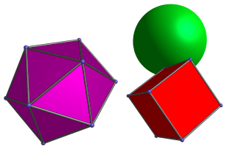
Computer Graphics ST0275
EAFIT University

Slide 2
Agenda
How to represent a 3D object as a polygon mesh.
Parametric surface
OctTrees
Projection of 3D objects to a 2D surface placing the camera in an arbitrary position

Slide 3
Motivation
The world we see is 3D
3D graphics are more powerful than 2D graphics
3D graphics are needed for
Games
Movies
Virtual Reality
…

Slide 4
Representation
In 2D, we needed two numbers to locate a point:
In polar coordinates: radius and angle
In the Cartesian plane: X and Y
In 3D, we need three degrees of freedom (3 numbers):
In cylindrical coordinates: radius, angle, height
In spherical coordinates: radius, 2 angles
In the Cartesian plane: X, Y and Z

Slide 5
Parametric equation of the line segment
2D:
x = x1 + t*(x2-x1)
y = y1 + t*(y2-y1)
t = [0..1]

Slide 6
Parametric equation of the line segment
3D:
x = x1 + t*(x2-x1)
y = y1 + t*(y2-y1)
z = z1 + t*(z2-z1)
t = [0..1]

Slide 7
In Summary:
Vector equation:
In 2D
In 3D

Slide 8
Planes in 3D
Plane equation:
If we have 3 vertices V1, V2, V3:
(V2 – V1) x (V3 – V2) yields normal vector N
N has the following components: A, B, C
In order to solve for D, you take A, B, C, and the coordinates of one point in the plane into equation (1)

Slide 9
Relationship between a point and a plane
V1, V2, V3 (in above equation) have to be numbered counterclockwise (looking at the polygon from the outside).
If Ax + By + Cz - D < 0 the point is inside
If Ax + By + Cz - D > 0 the point is outside
V2
N
V3
V1

Slide 10
How to represent an object in 3D?
As a polygon mesh
Using parametric surfaces (Bézier Curves, NURBS,…)
CSG (Constructive Solid Geometry)

Slide 11
Polygon Mesh
The most widely used
The object is wrapped in polygons
In some cases textures are added

Slide 12
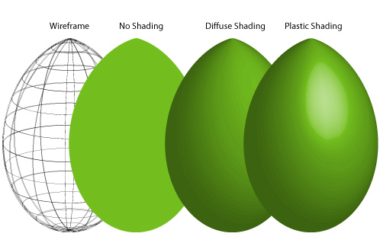
Objects as polygon meshes
Most operations for this representation are currently done in the Graphics Card
Once the mesh is created, the object can be rendered as:
“Wire-frame”
Solid
Texture mapped
Image from: http://z.about.com

Slide 13
Components of the mesh
Points
Segments of lines
Two different points form a line
Polygons
Three non co-linear points determine a plane

Slide 14
Data Structure
Initially, define a set of points (vertices)
P1
P3
P2
P5
P4

Slide 15
Data Structure
Define the edges that link the vertices
L1 = (P1, P2)
L2 = (P2, P3)
L3 = (P3, P1)
L4 = (P2, P4)
L5 = (P4, P5)
L6 = (P5, P3)
L7 = (P3, P2)
P1
P3
P2
P5
P4

Slide 16
Data Structure
Then define the polygons
Edges
P1 = (L1, L2, L3)
P2 = (L4, L5, L6, L7)
Vertices
P1 = (P1, P2, P3)
P2 = (P2, P4, P5, P3)
P1
P3
P5
P2
P4

Slide 17
Parametric Surfaces (will get back to this later)
Generalization of the Bezier curve
In the curve (even in space), only one parameter (u) is required.
For the surface, two parameters are needed: u and v (why?)

Slide 18
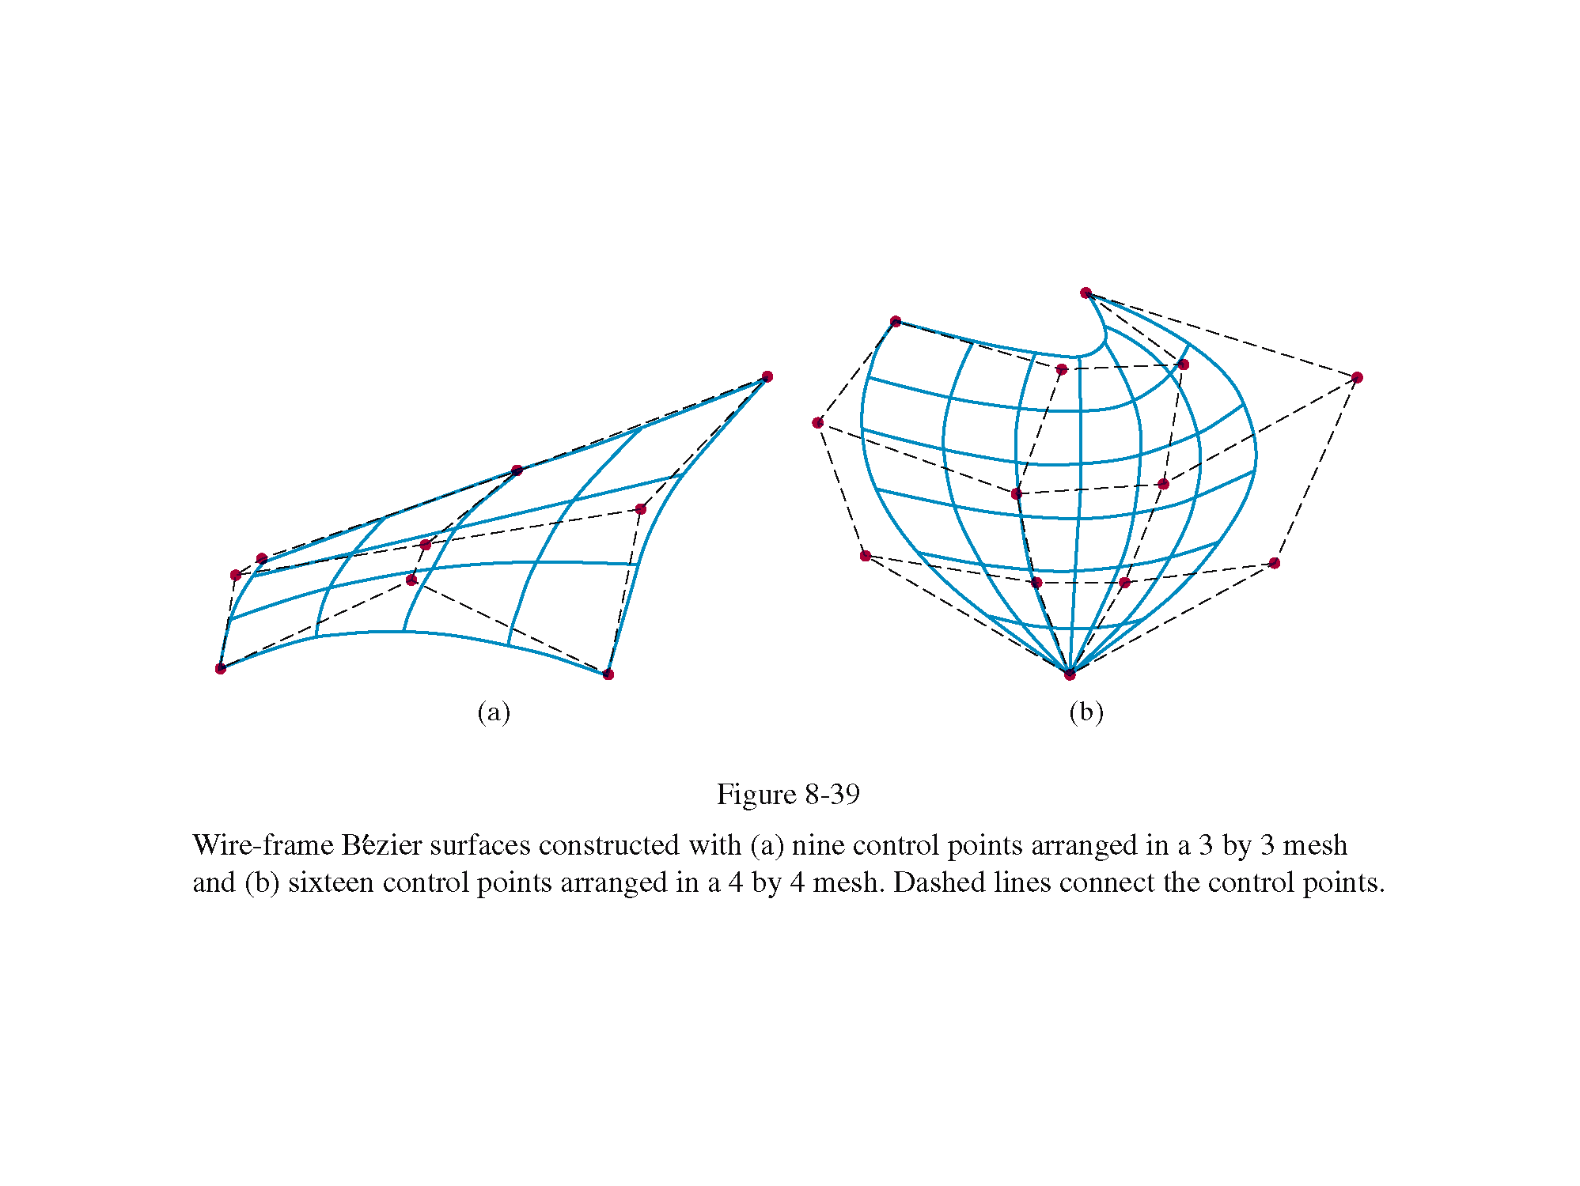
Parametric Surfaces

Slide 19
OctTrees
Octrees are volumetric representations of objects.
Elements are represented as large volumes of “voxels” (volumetric elements).
Each voxel has properties (color, density, …).

Slide 20
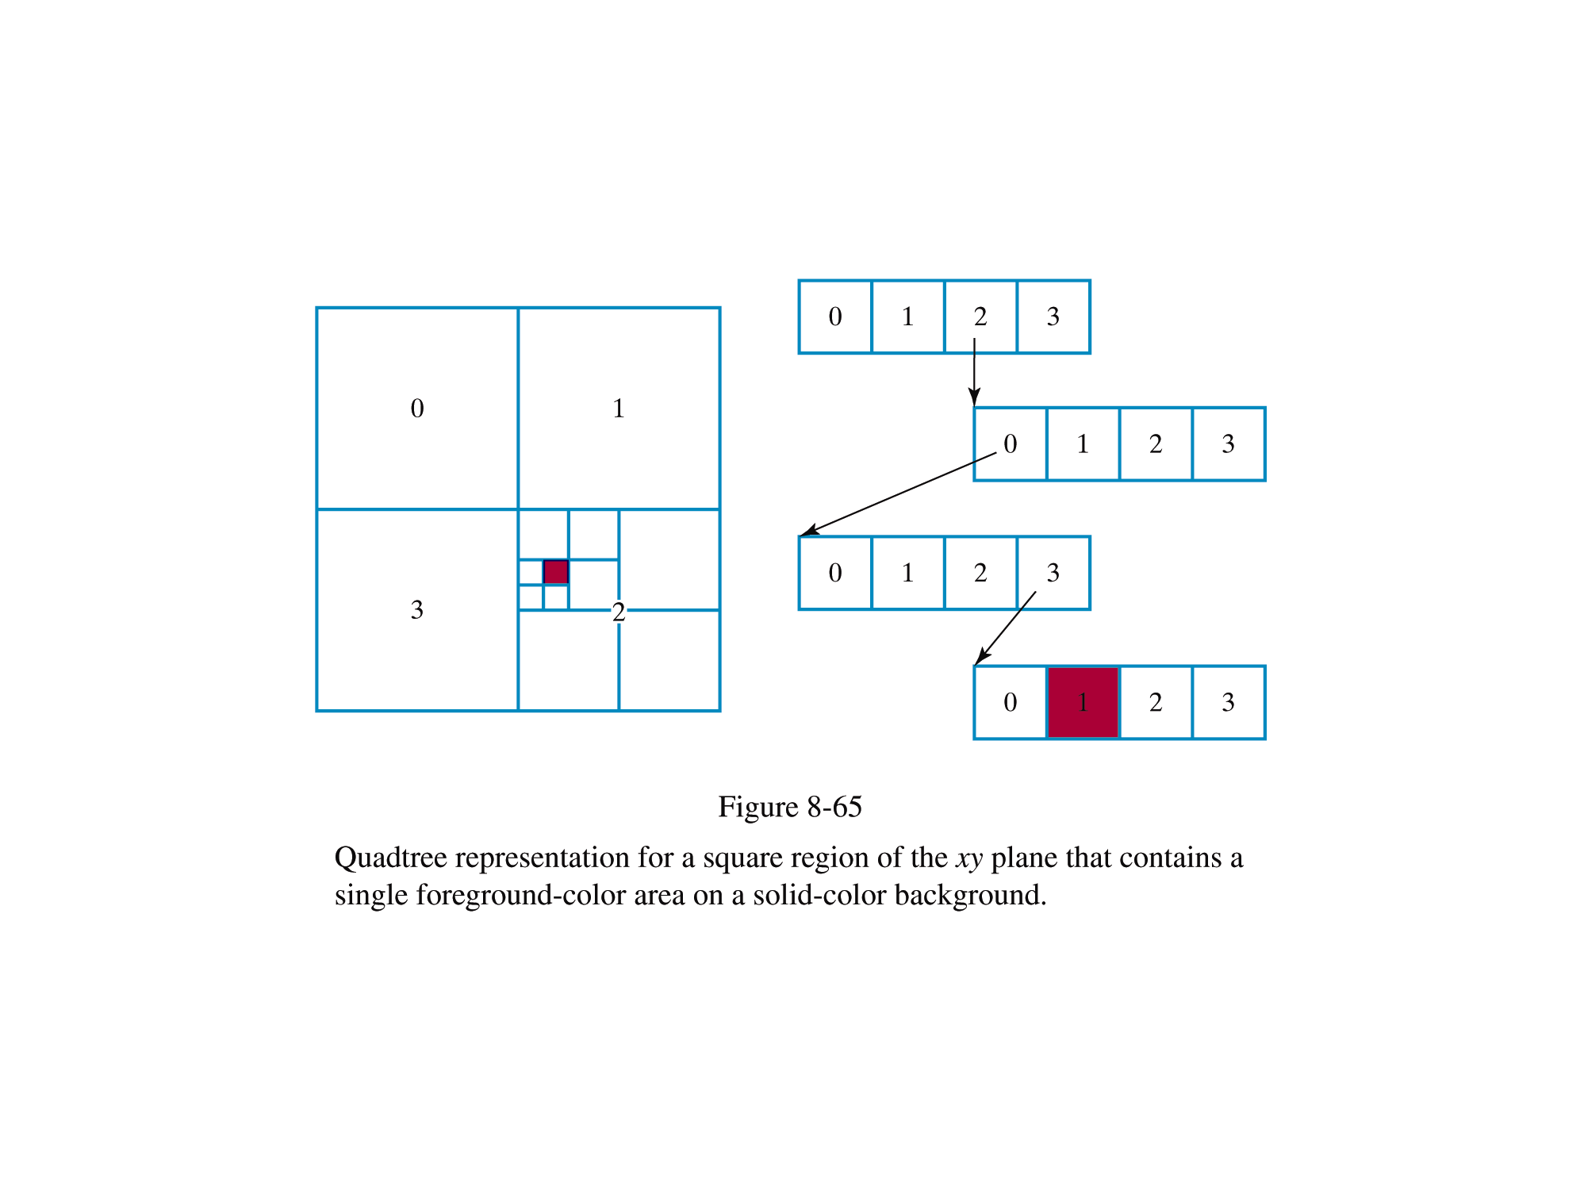
Quadtrees

Slide 21
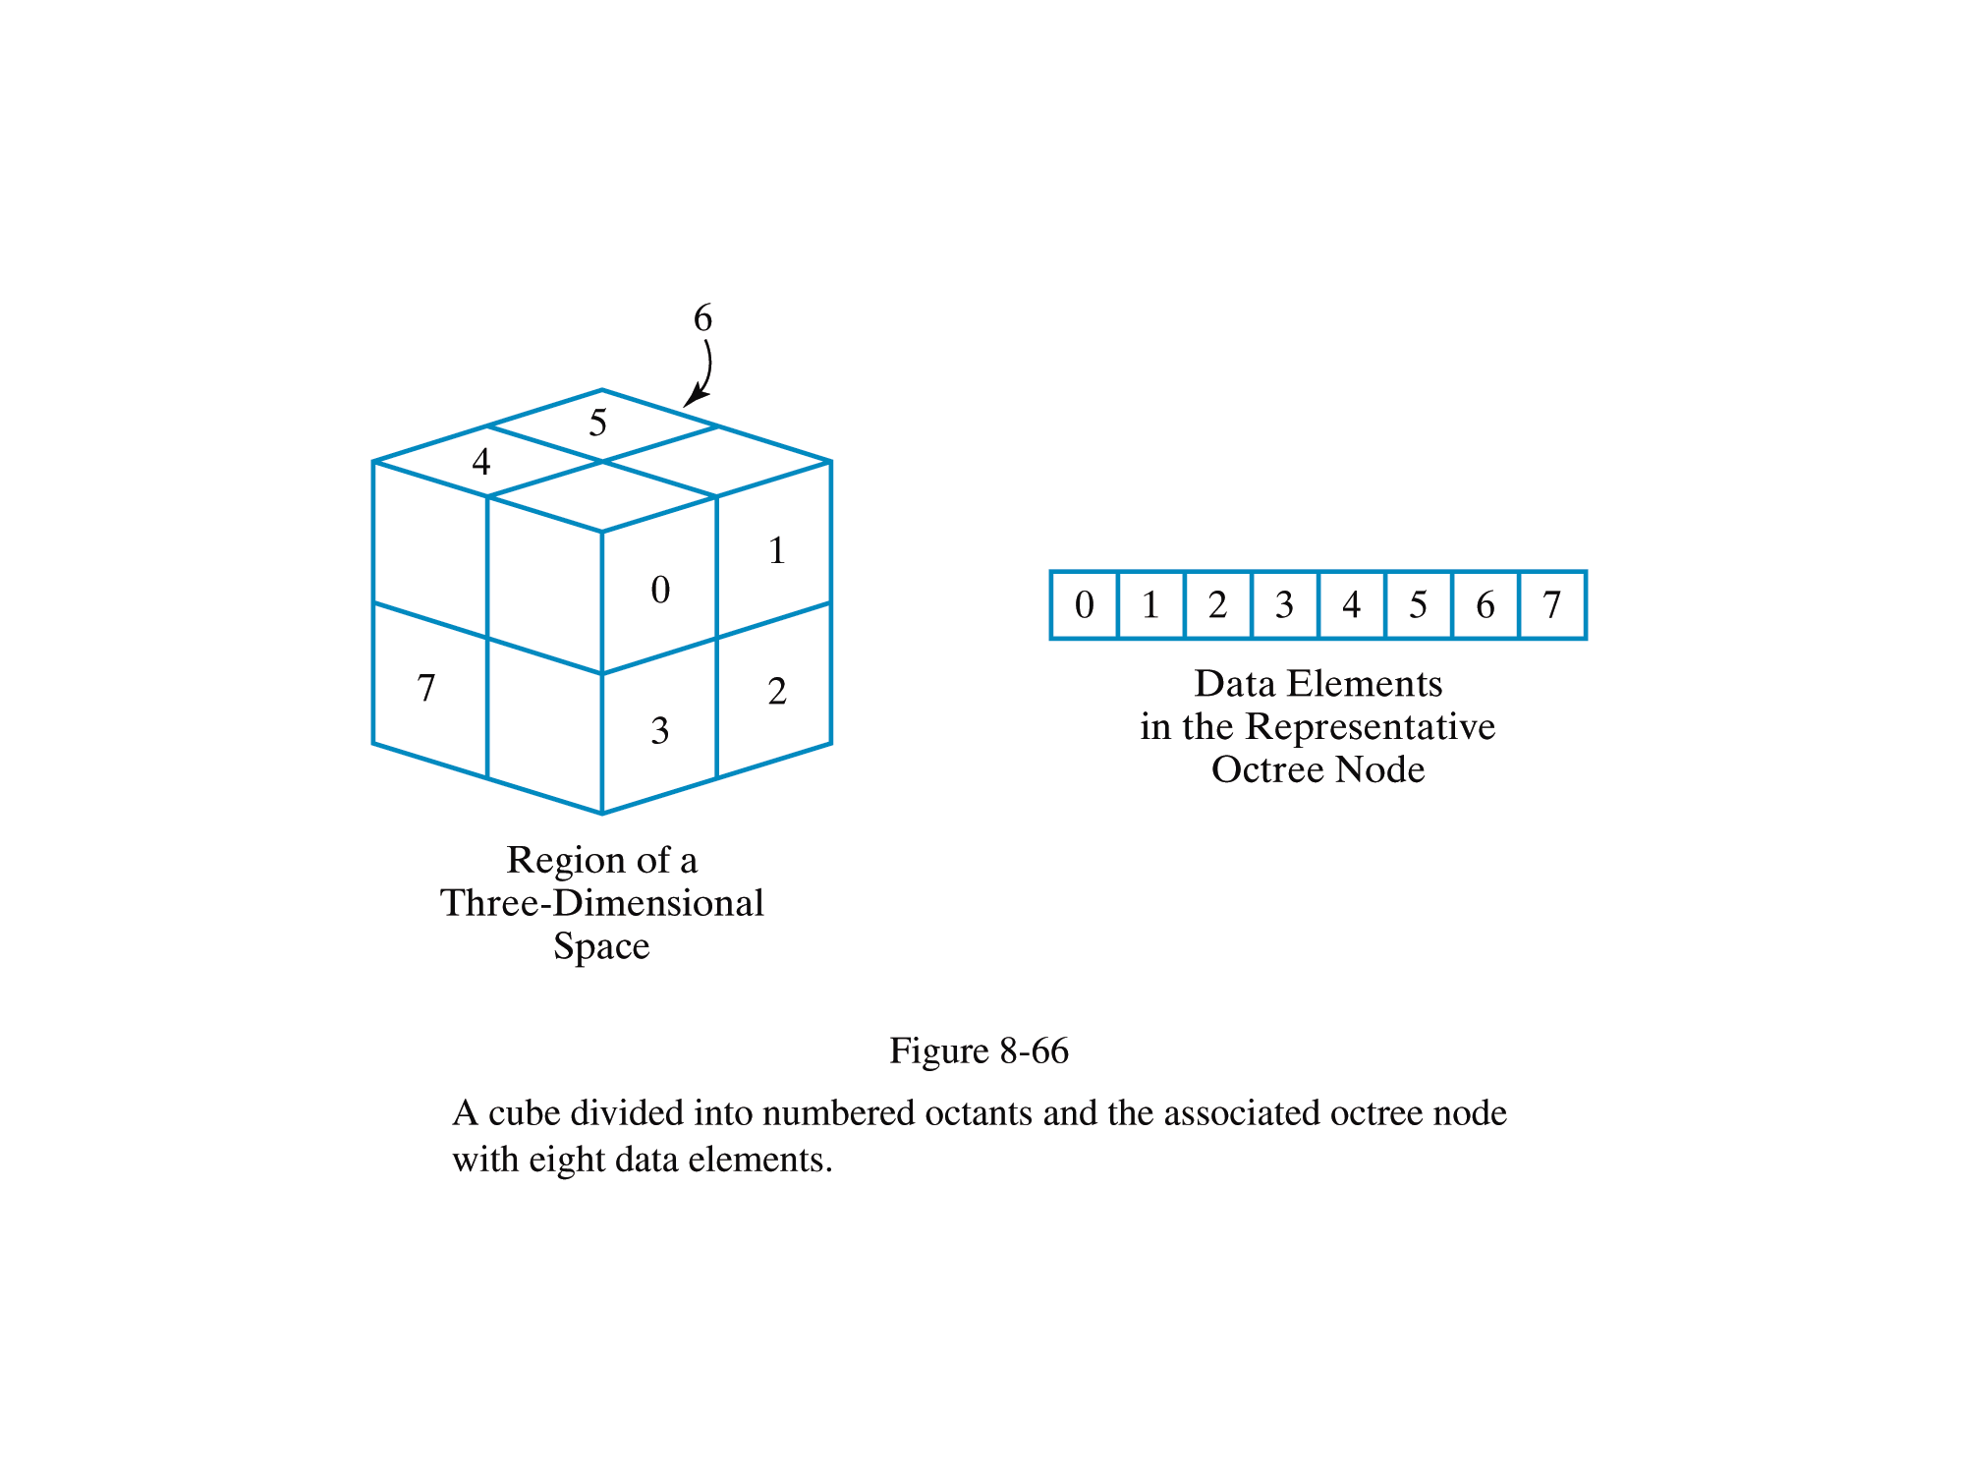
Octrees

Slide 22
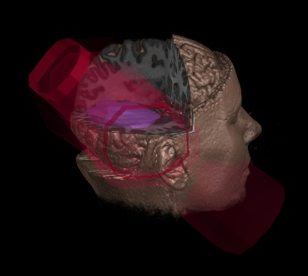
Volume Rendering
Visualización en 3D a partir de “cortes” 2D:
Image from: http://graphics.stanford.edu/projects/volume/

Slide 23
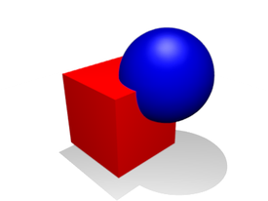
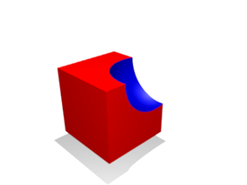

Constructive Solid Geometry
You can create new objects from existing ones by the following operations:
Union
Intersection
Subtraction

Slide 24
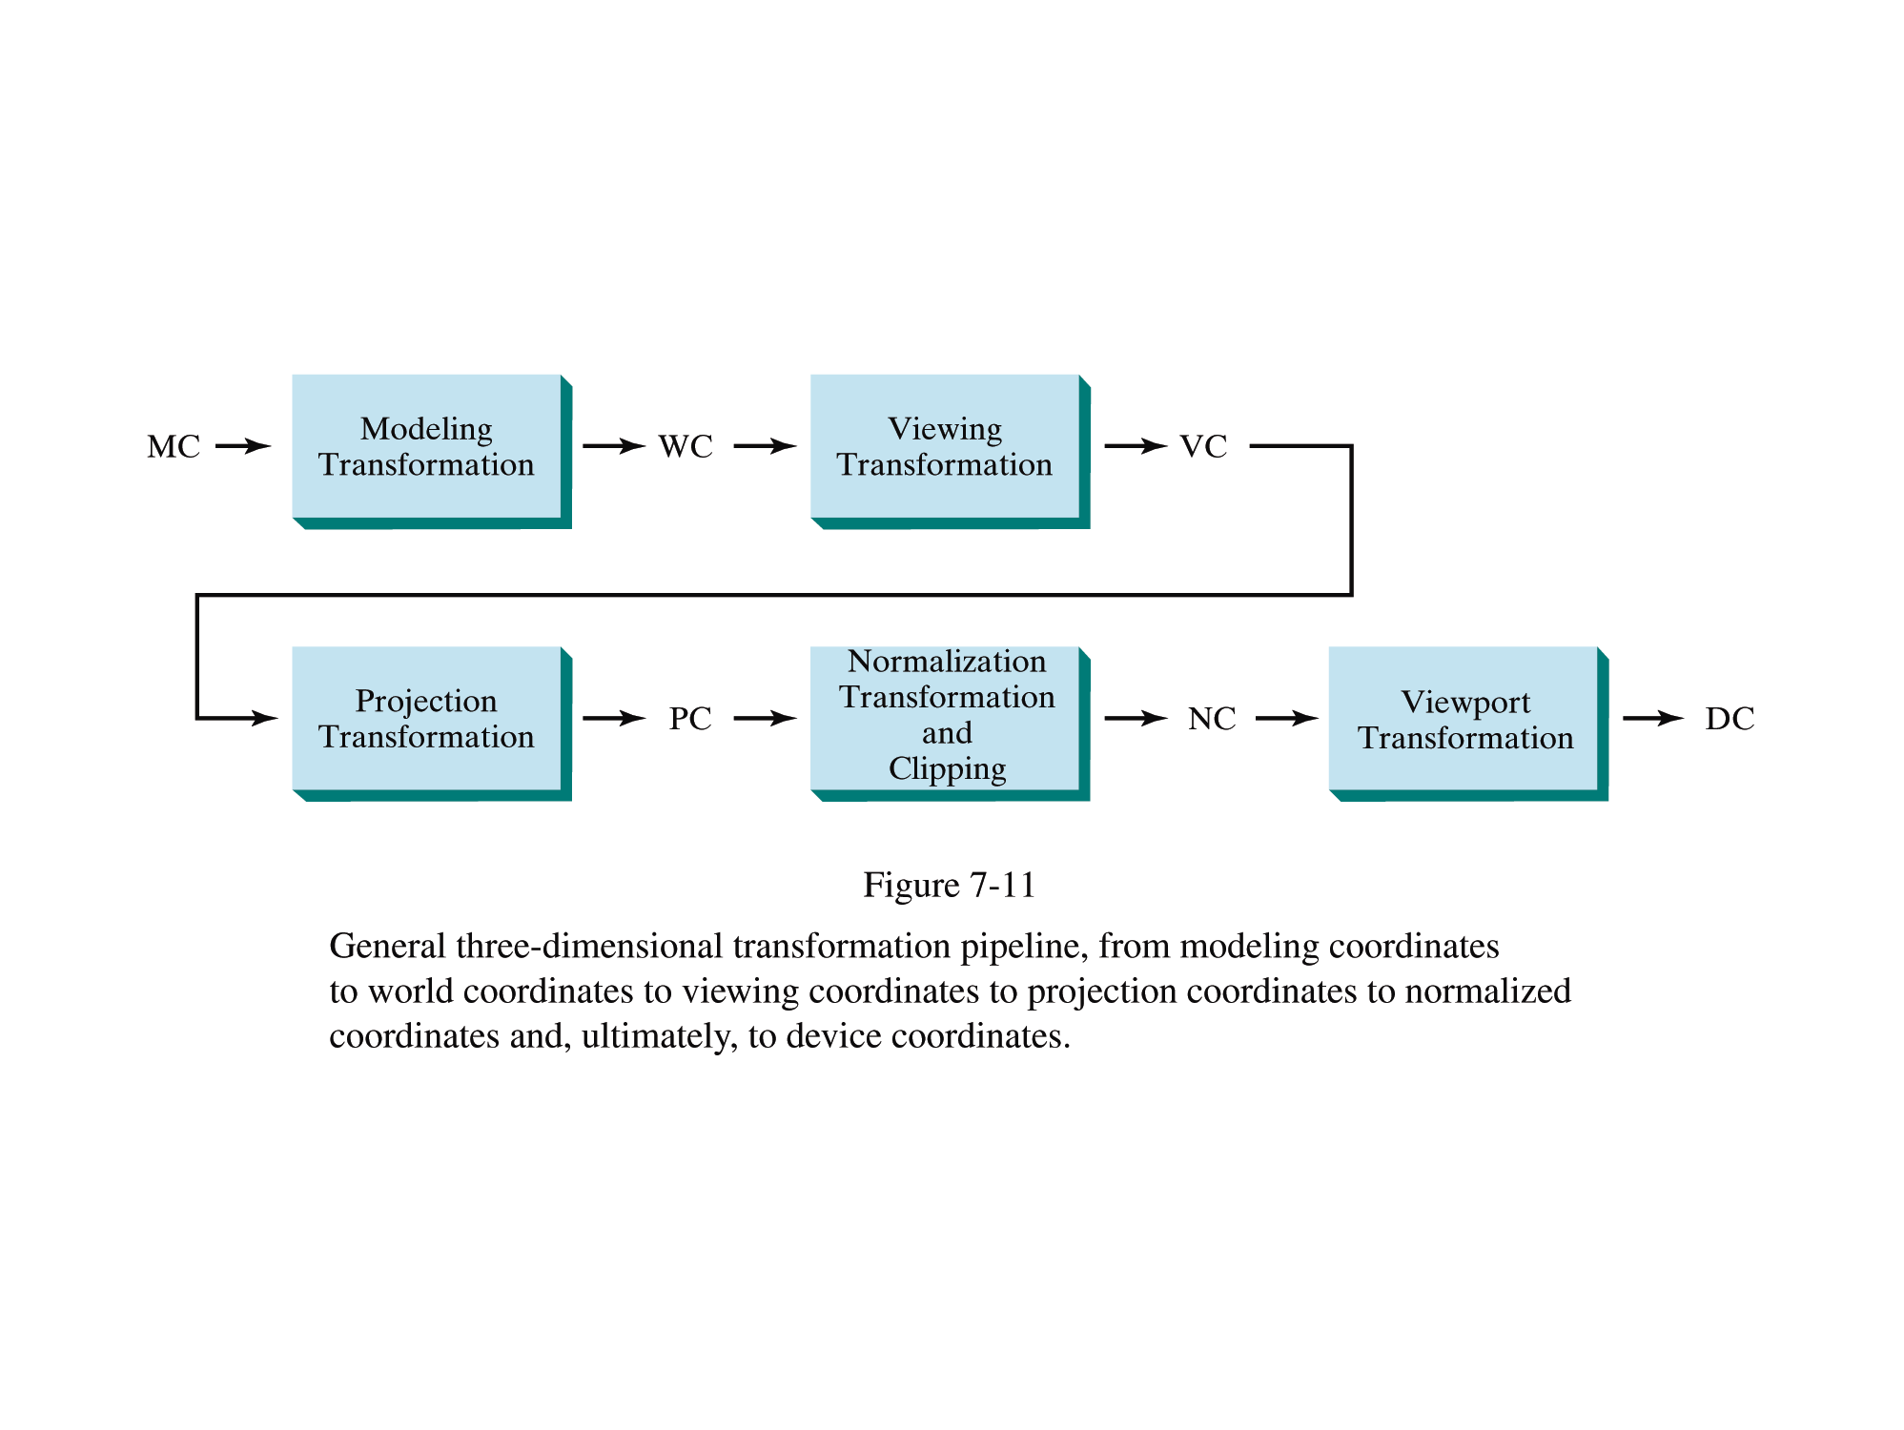
Projection
General 3D pipeline:

Slide 25
Projection
In a previous lesson, we defined the Projection Matrix
This assumes that the observer is looking in the “-z” direction.
P(x, y, z)
x_{p}
x
-z
d
d
-z
y_{p}
P(x, y, z)
y

Slide 26
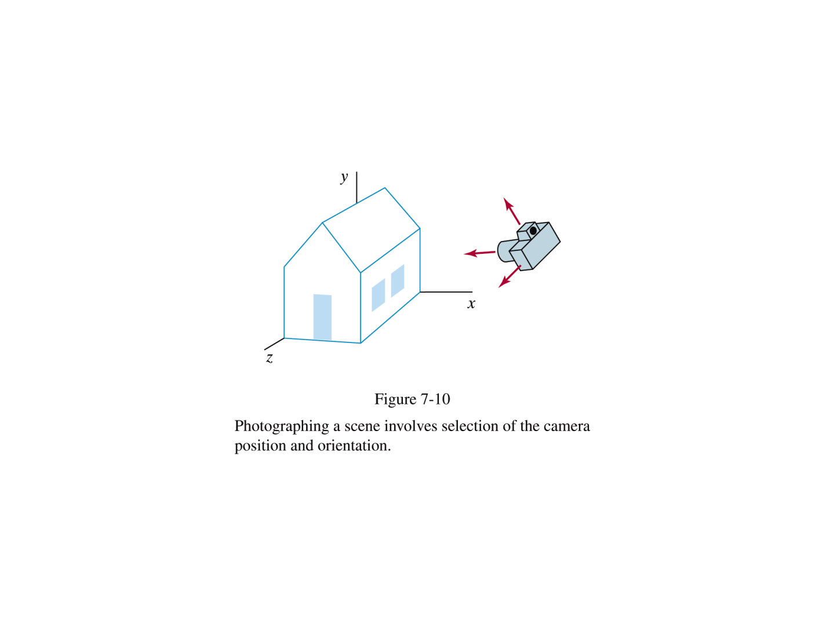
Projection
We have two coordinate system:
World and Camera

Slide 27
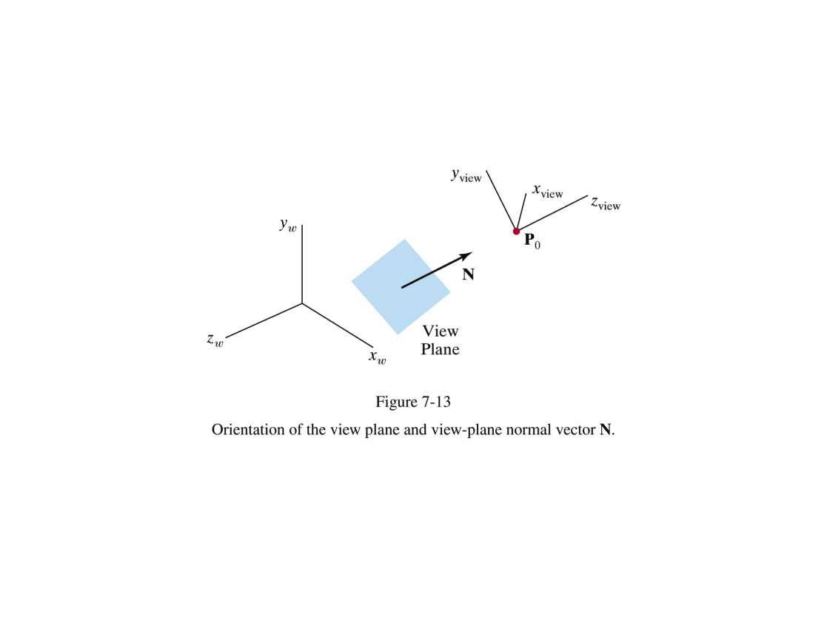
Projection
Question: How to express the object in terms of the camera system?
Answer: Transform the camera system so that it coincides with the world system.

Slide 28
Projection
For the virtual camera we need:
Position
Orientation
Looking-at vector (negative, actually, to make it a right-handed system) (we will call it n)
“Up” vector (we will call it V (note the capital))
Think of a photography camera
uvn is called an ortho-normal base.

Slide 29
Projection
1 Translate the camera and the objects in the secne coordinate system (C.S.) to the world C.S.

Slide 30
Projection
2 Define a right-handed set of axes that serve as camera C.S.
n: view plane normal vector (similar to Z)
V: non-orthogonal “up” vector (similar to Y)
v: orthogonal up vector
u: orthogonal “right” vector (similar to X)

Slide 31
Projection
Notice that
Are the cosine-direction angles of unitary vector n.
Same for vectors v and u.

Slide 32
Projection
3. So, the following matrix:
Will rotate the camera c.s. to coincide with the world c.s.
Why?

Slide 33
Projection
The coordinate transformation matrix is:

Slide 34
Projection
And then we can use the previous projection matrix

Slide 35
Example
Assume the camera is looking from <0,0,0> into the positive X direction. “Up” vector is <0,1,0>. Form the uvn orthonormal base.
Transform point <1,1,1> to the new base.

Slide 36
Credits
Graphs taken from Hearn & Baker, Computer Graphics with OpenGL, 3rd Edition, Chapter 8
First image from: http://eusebeia.dyndns.org/4d/vis/02-analogy
Reading: Hearn & Baker, sections 8-1, 8-21, 8-22.

